Slide 1
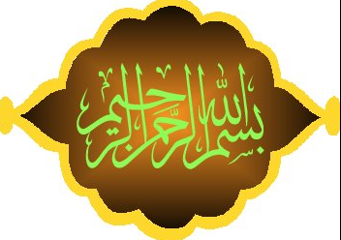

Slide 2

Semester : Fall
Bahria University, Karachi Campus
Project HR and Stakeholder Management
By
MS Department, BUKC
Notes:
The incidence of both lower incomes due to economic crisis and persistent high food prices has proved to be a devastating combination for the world’s most vulnerable populations.

Slide 3
Course Description
This core course integrates concepts of employing human resource and communication for optimally attaining project completion and optimization.
It combines various theoretical frameworks, historically significant events and experiential activities to give students a rich understanding of contemporary applications of HRM policies and practices.
Notes:
The incidence of both lower incomes due to economic crisis and persistent high food prices has proved to be a devastating combination for the world’s most vulnerable populations.

Slide 4
Objectives of the Course
To expose students to apply modern thinking on HR management for productive and multiplicative project conception and completion.
To help them understand stages of HR management techniques based on rationality, emerging technology, knowledge and global realities with communication as an effective integration tool.
To enlighten students for innovative thinking in availing opportunities in the real time business world.
Notes:
The incidence of both lower incomes due to economic crisis and persistent high food prices has proved to be a devastating combination for the world’s most vulnerable populations.

Slide 5
Learning Outcomes
Develop logical HR plans based on its basic functions for effective implementation in project management.
Analyze complex HR issues for producing prudent and workable solutions as project managers.
Develop an approach / attitude of reasoning based on fundamentals of HR management philosophy, basically building on knowledge, skills and attitude.
Notes:
The incidence of both lower incomes due to economic crisis and persistent high food prices has proved to be a devastating combination for the world’s most vulnerable populations.

Slide 6
Learning and Teaching Methodology
Mixed methodologies shall be put in practice for comprehensive learning. It includes Pedagogy and Andragogy. For this purpose students shall be involved in discussions, presentations and group activities.
Student shall be distributed into groups for mutual discussions; learn how to share works, prepare team based solution to problems and develop arguments for convincing presentations.
Notes:
The incidence of both lower incomes due to economic crisis and persistent high food prices has proved to be a devastating combination for the world’s most vulnerable populations.

Slide 7
Student Assignments
It is students’ responsibility to read referred chapters of the book and hand-outs given by the instructor and take part in class activities.
Students’ conduct in the class for effective learning, class attendance and useful participation in interactive sessions shall count towards final grading / assessment as appreciated / quantified by the instructor.
Notes:
The incidence of both lower incomes due to economic crisis and persistent high food prices has proved to be a devastating combination for the world’s most vulnerable populations.

Slide 8
Course – Preliminary Details
Course Title | Project HR and Stakeholder Management
Credit Hour | 3
Course Level | MS(PM)
Instructor
Email
Contact
Notes:
The incidence of both lower incomes due to economic crisis and persistent high food prices has proved to be a devastating combination for the world’s most vulnerable populations.

Slide 9
Reference Books
Guide to the Project Management Body of Knowledge, PMI Standards Committee by William R Duncan, Project Management Institute, Four Campus, Boulevard, New Town Square, USA.
Human Resource Management by Gary Dessler, 14th edition.
Notes:
The incidence of both lower incomes due to economic crisis and persistent high food prices has proved to be a devastating combination for the world’s most vulnerable populations.

Slide 10
Reference Journals
Journal of Management / Management Studies.
Journal of Management Education.
Journal of Organizational Behaviour.
Harvard Business Review.
Notes:
The incidence of both lower incomes due to economic crisis and persistent high food prices has proved to be a devastating combination for the world’s most vulnerable populations.

Slide 11
Case Studies / Articles Review
Groups of students shall be asked to critique the article / case of study in the class. Softcopy of the presentation / subject under discussion shall be given to the instructor a week before the class discussion.
Students should come prepared to give their views on the article / case. The discussion shall take place as per layout given.
Notes:
The incidence of both lower incomes due to economic crisis and persistent high food prices has proved to be a devastating combination for the world’s most vulnerable populations.

Slide 12
Assessment / Grading
Final Examinations - 40%
Mid Term Examinations - 30%
Assignments(20)/Quizzes(10) - 30%
Notes:
The incidence of both lower incomes due to economic crisis and persistent high food prices has proved to be a devastating combination for the world’s most vulnerable populations.

Slide 13
Main Topics of HRM & Communication Mgt
    Job Analysis
    Recruitment and Selection
    Training & Development
    Team Building / Teamwork
    Employee Motivation
    Performance Appraisal
    Compensation and Benefits
    Basic Communication Model
    Communication Management System
Notes:
The incidence of both lower incomes due to economic crisis and persistent high food prices has proved to be a devastating combination for the world’s most vulnerable populations.

Slide 14
Common Questions
Why should we study this course?
What is Role of HR in various aspects of PM?
What is importance of effective Communication in PM?
Notes:
The incidence of both lower incomes due to economic crisis and persistent high food prices has proved to be a devastating combination for the world’s most vulnerable populations.

Slide 15
Importance of P HRM & CM
What is a Project?
What is Management?
What is HR & its Management?
What is Communication & its Management?
Notes:
The incidence of both lower incomes due to economic crisis and persistent high food prices has proved to be a devastating combination for the world’s most vulnerable populations.

Slide 16
Importance of P (HR & C) M
What is a Project?
A temporary endeavor undertaken to create a unique product or service. Temporary means that every project has a definite beginning and a definite end. Unique means that product or service is different in some distinguishable way from all similar products or services.
What is Management?
Making the most effective use of available resources, whether in the form of machine, money or people aimed at achieving best possible results.
Notes:
The incidence of both lower incomes due to economic crisis and persistent high food prices has proved to be a devastating combination for the world’s most vulnerable populations.

Slide 17
Programs versus Projects
Program Defined
  A series of coordinated, related, multiple projects that continue over an extended time and are intended to achieve a goal.
  A higher level group of projects targeted at a common goal.
  Example:
    Project: completion of a required course in project management.
    Program: completion of all courses required for a business major.

Slide 18
Comparison of Routine Work with Projects
Routine, Repetitive Work
Taking class notes
Daily entering sales receipts into the accounting ledger
Responding to a supply-chain request
Practicing scales on the piano
Routine manufacture of an Apple iPod
Attaching tags on a manufactured product
Projects
Writing a term paper
Setting up a sales kiosk for a professional accounting meeting
Developing a supply-chain information system
Writing a new piano piece
Designing an iPod that is approximately 2 X 4 inches, interfaces with PC, and stores 10,000 songs
Wire-tag projects for GE and
Wal-Mart
TABLE 1.1

Slide 19
Importance of P HRM & CM
What is HR?
All types of employees, whether permanent or temporary, who are contributing towards achievement of organizational goals.
(HR) is the way to desing strategic planning for effective decision making that can help to integrate andfmanaging an organization's most valuable asse such as employees (temp or permanent blue and white collar both) to achieve a competitive advantage. Moreover, HR comprise of an organization’s capital to manage employees with organizations business objectives to augment organizational performance, foster and promote a positive work culture for employee gratification , and ensure compliance with labor laws
Notes:
The incidence of both lower incomes due to economic crisis and persistent high food prices has proved to be a devastating combination for the world’s most vulnerable populations.

Slide 20
What is HR Management?
The process of acquiring, training, appraising and compensating employees and of attending to their labour relations, health & safety and fairness concerns.
Ensuring best utilization of employees (team members) by keeping them professionally competent and highly motivated, with an aim to get optimum results.

Slide 21
Importance
The bottom line of managing HR is best Getting results. HR creates value by engaging in activities that produce the employee behaviors that the company needs to achieve its strategic goals. Such as promote concept of Kaizen , 5S and other improvement programs
Why is HRM important for All Managers?
Simply because all managers want to avoid following mistakes:
Hire/place wrong person for the job
Experience high turnover (low retention) Overhead cost , when employee leaves may b critical in case of critical or confidential data
Subordinate/ employee not doing the job (deficient)
Notes:
The incidence of both lower incomes due to economic crisis and persistent high food prices has proved to be a devastating combination for the world’s most vulnerable populations.

Slide 22
Importance of P HRM & CM
Waste time with useless interviews (during hiring & after)
Have your company taken to court due to violation of labour laws (feeling of discrimination / violation of equal employment opportunity, should not be biased one)
Have your company cited under occupational safety laws for unsafe practices.
Have your employee think their salaries are unfair relative to others in the organization
Allow a lack of training to undermine your department’s effectiveness
Commit any unfair practices.
Notes:
The incidence of both lower incomes due to economic crisis and persistent high food prices has proved to be a devastating combination for the world’s most vulnerable populations.

Slide 23
Importance of P HRM & CM
What is Communication?
Transference of ideas from one head to the other. Exchange of information with an aim to help an organization in achieving its goals.
Also includes free flow of information vertically, horizontally and diagonally, without any distortion or delay.
Notes:
The incidence of both lower incomes due to economic crisis and persistent high food prices has proved to be a devastating combination for the world’s most vulnerable populations.

Slide 24
The New HR Manager
In his/her new role as strategic partner, HR manager has to deal with a number of challenges:
They focus more on strategic, big-picture issues and act as Strategic HR Manager (SHRM) (formulating & executing HR policies & practices that produce employee competencies & behaviors that company needs to achieve its strategic goals)
They focus on improving performance
They measure HR performance & results
They use evidence based HRM (all HR related decisions based on evidence)
They add value (keep raising the bar)
Notes:
The incidence of both lower incomes due to economic crisis and persistent high food prices has proved to be a devastating combination for the world’s most vulnerable populations.

Slide 25
The New HR Manager
They use new ways to provide HR Services (use of technology to support HR activities)
They adopt talent management approach (goal oriented & integrated process of planning, recruiting, developing, managing & compensating employees)
They manage employee engagement (engaged employees are mentally & emotionally invested in their work and in contributing to an employer’s success)
They manage ethics (standards of acceptable conduct)
They understand their HR Philosophy (to give opportunity for full exercise of talent)
They have new competencies eventually helps in their growth)
Notes:
The incidence of both lower incomes due to economic crisis and persistent high food prices has proved to be a devastating combination for the world’s most vulnerable populations.

Slide 26
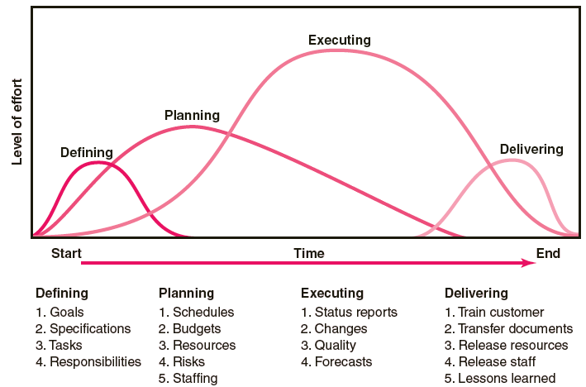
Project Life Cycle

Slide 27
Characteristics of Objectives
S Specific Be specific in targeting an objective
M Measurable Establish a measurable indicator(s) of progress
A Assignable Make the objective assignable to one person for completion
R Realistic State what can realistically be done with available resources
T Time related

Slide 28
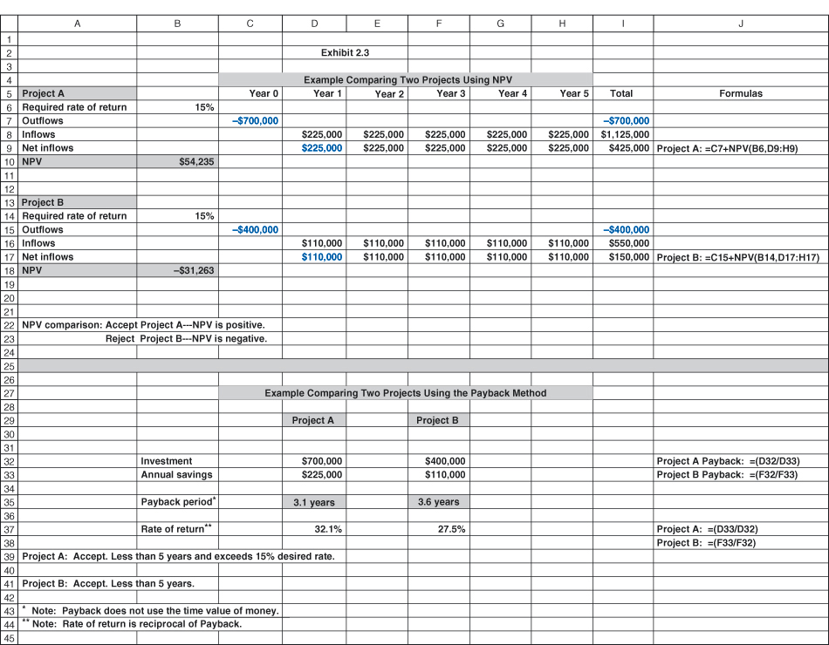

Slide 29
Nonfinancial Criteria
To capture larger market share
To make it difficult for competitors to enter the market
To develop an enabler product
To develop core technology that will be used in next-generation products
To reduce dependency on unreliable suppliers
To prevent government intervention and regulation
To capture larger market share
To make it difficult for competitors to enter the market
To develop an enabler product
To develop core technology that will be used in next-generation products
To reduce dependency on unreliable suppliers
To prevent government intervention and regulation

Slide 30
Key Checklist for Selection Model
Strategy alignment: What specific organization does this project align with?
Driver: What business problem does the project solve?
Success metrics: How will we measure success?
Sponsorship: Who is the project sponsor?
Risk: What is the impact of not doing this project and What is the project risk to our organization?
Benefits: What is the value of the project to this organization?
Organization culture: Is our organization culture right for this type of project?
Approach: Will we build or buy?
Training/resources: Will staff training be required?
Finance: What is estimated cost of the project?
Portfolio: How does the project interact with current projects?

Slide 31
Types of Costs
Direct Costs
  Costs that are clearly chargeable to a specific work package.
    Labor, materials, equipment, and other
Direct (Project) Overhead Costs
  Costs incurred that are directly tied to an identifiable project deliverable or work package.
    Salary, rents, supplies, specialized machinery
General and Administrative Overhead Costs
  Organization costs indirectly linked to a specific package that are apportioned to the project

Slide 32
Refining Estimates
Reasons for Adjusting Estimates
  Interaction costs are hidden in estimates.
  Normal conditions do not apply.
  Things go wrong on projects.
  Changes in project scope and plans.
Adjusting Estimates
  Time and cost estimates of specific activities are adjusted as the risks, resources, and situation particulars become more clearly defined.

Slide 33
Refining Estimates (cont’d)
Contingency Funds and Time Buffers
  Are created independently to offset uncertainty.
  Reduce the likelihood of cost and completion time overruns for a project.
  Can be added to the overall project or to specific activities or work packages.
  Can be determined from previous similar projects.
Changing Baseline Schedule and Budget
  Unforeseen events may dictate a reformulation of the budget and schedule.

Slide 34
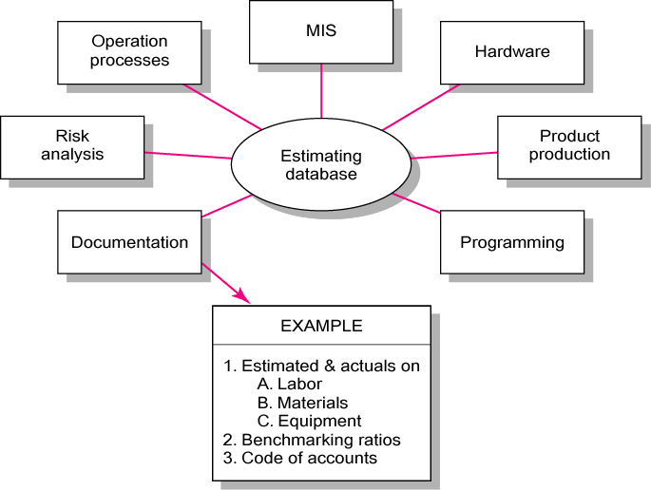
Creating a Database for Estimating
Estimating Database Templates

Slide 35
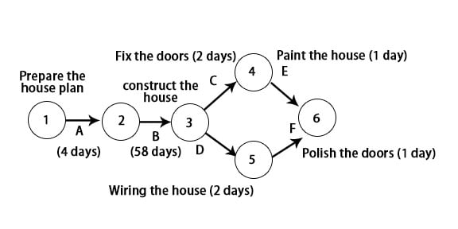

Slide 36
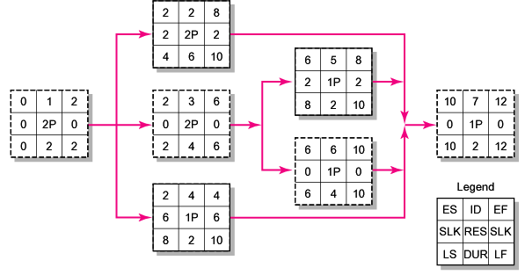
Thanks
Notes:
The incidence of both lower incomes due to economic crisis and persistent high food prices has proved to be a devastating combination for the world’s most vulnerable populations.

Slide 39
DIVERSITY AND CULTURE

Slide 40
What is Diversity?
Diversity refers to the variety or multiplicity of demographic features that characterize a company’s workforce, particularly in terms of race, sex, culture, national origin, handicap, age and religion.
Diversity leads to better performance and innovation provided it is well managed.

Slide 41
Levels of Diversity
Surface-levels Diversity. Differences in easily perceived characteristics, such as gender, race, ethnicity, age, disability etc. that do not necessarily reflect the ways people think or feel but may activate certain stereotypes.
Deep-levels Diversity. Differences in values, personality and work preferences that become progressively more important for determining similarity as people get to know one another better.

Slide 42
Levels of Diversity
Discrimination. Taking specific actions towards or against the employees/people on the basis of their differences. Usually it has negative connotation.
Unfair discrimination means making judgments about individuals based on stereotypes regarding their demographic groups. It also means creation of undue differences between genders, ages, family backgrounds etc., which leads to de-motivation and may lead to law-suits

Slide 43
Biographical Characteristics
Biographical Characteristics:
Personal characteristics—such as age, gender, and marital status—that are objective and easily obtained from personnel’s records.
Age. Age has both merits & demerits. Employers have different perception about old and young employees. It is usually said that age has no direct relationship with productivity. Older workers have more wisdom, judgment, experience, strong work ethics and more commitment towards work. Moreover, they are less likely to resign, have fewer absences, less turnover and report higher job satisfaction than the young ones.

Slide 44
Biographical Characteristics
Biographical Characteristics:
Gender/Sex. There are few important differences between men and women that do affect their job performance; however, these differences should not be used as discriminatory tool.
Working mothers prefer part-time work and flexible schedules and telecommuting in order to accommodate family responsibilities; some sort of work-life balance.
Research shows that women have higher absenteeism rate as compared to men, due to family commitments but this is more so for married women.

Slide 45
Biographical Characteristics
  Marital Status. Although married female employees have specific problems that affect their job; there are indications that they have fewer absences, undergo less turnover and show more job satisfaction.
  Tenure/ Seniority. There is positive relationship between productivity and seniority. Similarly, old employees have less turnover ‘past history is the best predictor of future performance’.
  Disability. Disable people may also be accommodated if they are suitable for the job.

Slide 46

Ability, Intellect, and Intelligence
Ability:
An individual’s capacity to perform the various tasks in a job.
Physical Ability:
The capacity to do physical activities.
Intellectual Ability:
The capacity to do mental activities.
General Mental Ability (GMA): An overall factor of intelligence, as suggested by the positive correlations among specific intellectual ability.

Slide 47
Dimensions of Intellectual Ability
DIMENSION | DESCRIPTION | JOB EXAMPLE
Number aptitude | Ability to do speedy and accurate arithmetic | Accountant: Computing the sales tax on a set of items
Verbal comprehension | Ability to understand what is read or heard and the relationship of words to each other | Plant manager: Following corporate policies
Perceptual speed | Ability to identify visual similarities and differences quickly and accurately | Fire investigator: Identifying clues to support a charge of arson
Inductive reasoning | Ability to identify a logical sequence in a problem and then solve the problem | Market researcher: Forecasting demand for a product in the next time period
Deductive reasoning | Ability to use logic and assess the implications of an argument | Supervisor: Choosing between two different suggestions offered by employees
Spatial visualization | Ability to imagine how an object would look if its position in space were changed | Interior decorator: Redecorating an office
Memory | Ability to retain and recall past experiences | Salesperson: Remembering the names of customers

Slide 48

Physical Abilities
Physical Abilities:
The capacity to do tasks demanding stamina, dexterity, strength, and similar characteristics.

Slide 49


Nine Basic Physical Abilities
Dimension | Dimension Types | Description
Strength Factors | Dynamic strength Trunk strength Static strength Explosive strength | Ability to exert muscular force repeatedly or continuously over time Ability to exert muscular strength using the trunk (particularly abdomen) muscles Ability to exert force against external objects Ability to expend a maximum of energy in one or a series of explosive acts
Flexibility Factors | Extent flexibility Dynamic flexibility | Ability to move the trunk and back muscles as far as possible Ability to make rapid, repeated flexing movements
Other Factors | Body coordination Balance Stamina | Ability to coordinate the simultaneous actions of different parts of the body Ability to maintain equilibrium despite forces pulling off balance Ability to continue maximum effort requiring prolonged effort over time

Slide 50
Diversity Management
Diversity Managememnt:
The process and programs by which managers make everyone more aware of and sensitive to the needs and differences of others. Diversity is likely to be more useful if every realizes its importance and is ready to accept it.
Affirmative Action:
Steps taken for the purpose of eliminating the present effects of past discrimination.

Slide 51
Diversity Management
Diversity management is undertaken to avoid workplace discriminatory practices :
Recruitment:
World of Mouth regarding job opportunities should be avoided as it may create a perception about favoring some particular group.
Misleading information to bar some members of any group to apply for some job.
Help Wanted Ads only for males or only for females are considered unethical, unless gender is bona fide requirement for a job.

Slide 52
Diversity Management
Selection Standards:
Tests which are irrelevant to the job should be avoided.
Reference to relatives or Known candidates will deprive the organization from hiring brilliant people.
Height, weight or physical characteristics are unethical unless any justification is given.
Arrest records are considered unethical; such cases may be decided on case-to-case basis.
Application forms should not contain questions about disabilities, marital status, age, citizenship.

Slide 53
Diversity Management Practices
Diversity management aims at maximizing diversity’s potential benefits while minimizing its potential barriers. Special attention should be paid to national culture of employees for better management of workplace diversity.
Diversity management usually involves five steps:
Provide strong leadership (top leadership acting as role model to encourage diversity)
Assess the Situation (assess nature of diversity and what are issues to be addressed)
Provide diversity training and education (highlight merits of diversity and giving importance/ respect to diverse people)

Slide 54
Diversity Management Practices
Change culture and management system (workplace culture should demonstrate through words and actions and managers should follow established workplace values)
Evaluate diversity management programs (may conduct a survey to get views of employees about usefulness of the diversity rpogram.

Slide 55
Diversity Management Practices
Educate managers on EEO.
Emphasize on benefits of diversity in both formal and informal sessions/meetings.
Foster personal development practices and acknowledge value of diverse talent.
Continuous diversity training to be included in the annual training program.
Look for any barriers for equal opportunity for advancement.

Slide 56
ORGANIZATIONAL CULTURE AND ENVIRONMENT

Slide 57
Organizational Culture
Organizational Culture: It is described as the shared values, principles, traditions, the way of doing things that influence the way organizational members act.
Values: These are the preferred modes of actions that employees adopt over the converse actions,

Slide 58
Omnipotent Vs Symbolic View of Management
Omnipotent View: The view that managers are directly responsible for an organization’s success or failure.
Symbolic View: The view that much of an organization’s success or failure is due to external forces outside manager’s control.
What Reality Suggests: In reality managers are neither all powerful nor helpless; they have to work under various constraints.
Managerial Discretion
Org Environment
Org Culture

Slide 59
Organizational Culture
Organizational culture refers to shared values, principles, traditions, and ways of doing things that influence the way organizational members act. An organization may have a strong or weak culture:
  Strong culture: Organizational culture in which the key values are intensely held and widely shared.
  Weak culture: Organizational culture in which key values are limited to a group of employee, usually among the members of top management.

Slide 60
Dimensions of Strong and Weak Culture
Strong Culture | Weak Culture
Values widely shared Culture conveys consistent messages about what is important. Most employees can tell stories about company history/heroes. Employees strongly identify with culture Strong connection exists between shared values and behaviors . | Values limited to few people – usually top management Culture sends contradictory messages about what is important. Employees have little knowledge of company history or heroes. Employees have little identification with culture. There is little connection between shared values and behaviors.

Slide 61
Dimensions of Organizational Culture
Attention to details
Innovation & Risk Taking
Outcome orientation
Organizational Culture
Stability
People orientation
Aggressive-ness
Team orientation

Slide 62
Dimensions of Organizational Culture
Attention to detail: Degree to which employees are expected to exhibit precision, analysis and attention to detail.
Outcome Orientation: Degree to which managers focus on results or outcomes rather than on how these outcomes are achieved.
People Orientation: Degree to which management decisions take into account the effects on people in the organization.
Team Orientation: Degree to which work is organized around teams rather than individuals.

Slide 63
Dimensions of Organizational Culture
Aggressiveness: Degree to which employees are aggressive and competitive rather than cooperative.
Stability: Degree to which organizational decisions and actions emphasize maintaining the status quo.
Innovation and Risk Taking: Degree to which employees are encouraged to be innovative and to take risks.

Slide 64
Ethical Culture
Ethical culture: A culture composed of values, traditions, and practices which are perceived to be ethical is called an ethical culture. Following are the suggestions of creating an ethical culture:
  Be a visible role model
  Communicate ethical expectations
  Provide ethics training
  Visibly reward ethical acts and punish unethical ones.
  Provide protective mechanisms so that employees can discuss ethical dilemmas and report unethical behavior without fear.

Slide 65
Innovative Culture
An innovative culture is the one and is the desire of every organization; it has following characteristics:
Challenge & involvement: Employees should be involved in, motivated by and committed to long term goals and success of the organization.
Freedom: Employees should be allowed to independently define their work, exercise discretion and take initiative in day to day activities.
Trust & openness: Employees should be supported and respectful to each other.
Idea time: Employees should have time to elaborate on new ideas before taking action.

Slide 66
Innovative Culture
Playfulness/humor: The workplace should be spontaneous, natural and full of fun.
Conflict resolution: Employees should be empowered to make decisions and resolve issues, in the best interest of organization.
Debates: Employees should be allowed to express their opinions and put forth ideas for consideration and review.
Risk taking: Managers should tolerate uncertainty and ambiguity and employees should be rewarded for risk taking.

Slide 67
Creating A Customer-Responsive Culture
A customer responsive culture has following characteristics:
Characteristics | Suggestions for Managers
Type of employees | Hire people with personalities & attitudes consistent with customer service – friendly, attentive, enthusiastic, patient, good listener.
Type of job environment | Design job so that employees have as much control as possible to satisfy customers, without rigid rules and procedures.
Empowerment | Give employees discretion to make day to day decisions on job related activities.
Role clarity | Reduce uncertainty about what employees can and cannot do by continual training on product knowledge, listening, & other behavioral skills.
Consistent desire to satisfy & delight customers. | Clarify organization’s commitment to doing whatever it takes, even if it is outside one’s normal job requirements.

Slide 68
Spirituality and Organizational Culture
Workplace Spirituality: A feature of a culture where organizational values promote a sense of purpose through meaningful work that takes place in the context of community. Such an organization recognizes that people have a mind and a spirit who seek to find meaning & purpose in their work and desire to connect with other human beings and be part of the community. A spiritual organization has following five characteristics:
  Strong sense of purpose
  Focus on individual development
  Trust and openness
  Employee empowerment
  Toleration of employee expression

Slide 69
Influence of External Environment
External environment: It refers to the factors and forces outside an organization that affect the organization’s performance. It has two components – specific environment and general environment:
  Specific environment: External forces that have a direct impact on manager’s decisions and actions and are directly relevant to the achievement of an organization’s goal. Main forces that make up specific culture are:
  Customers
  Suppliers
  Competitors
  Pressure groups

Slide 70
Influence of External Environment
General environment: General environment includes the broad external conditions that may affect an organization. During various managerial functions, these factors should be kept in mind, which are:
    Economic conditions
    Political/Legal, conditions
    Socio-cultural conditions
    Demographic conditions
    Technological conditions
    Global conditions

Slide 71
Thank You

